Slide 1


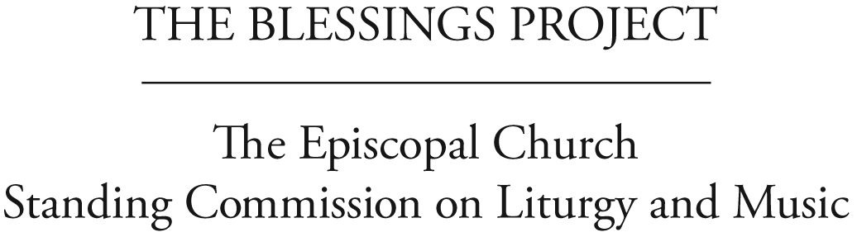
Helping Dioceses Understand
the response to 2009 GC Resolution C056
Liturgies for Blessing
Same-Gender Relationships
Liturgical Principles

Slide 2
How We Got Here
The Episcopal Church’s General Convention working for 35 years:
1976: First discussion and resolution:
homosexual persons are children of God
2000: Clarity about same-gender couples:
such relationships will be characterized by fidelity, monogamy, mutual affection and respect, careful, honest communication, and holy love
2003: Liturgies celebrating/blessing relationship:
within the bounds of our common life
Discussions and resolutions also in
1985,1991, 1994, 1997
Notes:
Quickly show the process that got us here via General Convention resolutions and the SCLM’s charge and work on C-056.

Slide 3
Resolution 2009-C056
General Convention:
Acknowledged that changing circumstances in civil realities needed renewed pastoral response
Asked for an open process inviting wide participation
Asked the Standing Commission on Liturgy and Music to:
  Work with the House of Bishops, collect and develop theological and liturgical resources for blessing same-gender relationships and report back in 2012
  Honor the theological diversity of this Church in regard to matters of human sexuality
  Encourage church members to engage in this effort
Notes:
Quickly show the process that got us here via General Convention resolutions and the SCLM’s charge and work on C-056.

Slide 4
In response, the SCLM . . .
Formed 4 Task Groups: Liturgy, Theology, Pastoral & Teaching, Civil/Canon Law
Met and consults with the House of Bishops
Held Province I Hearing (testimony from 33 people, lay and ordained)
Conducted church-wide survey regarding pastoral counseling and teaching materials (received responses from 1,131 people from 111 dioceses and all 9 Provinces)
Held Church-wide Consultation (included 194 deputies, lay and clergy, from 96 dioceses)
Asked outside consultants to review draft material (comments from 133 people, lay and ordained, from all 9 Provinces)
Invited reflection at the International Anglican Liturgical Consultation (55 people from 19 Anglican Provinces)
Notes:
Quickly show the process that got us here via General Convention resolutions and the SCLM’s charge and work on C-056.

Slide 5
Liturgical Reflection
Reflect on an Episcopal liturgy (such as a wedding, blessing, baptism, or eucharist) that you recently attended or find particularly memorable. Review the document Principles for Evaluating Liturgical Materials. Briefly discuss:
What about the liturgy was most memorable? What has remained with you to this day?
Did the liturgy reflect any of the “qualities” noted in the Principles?
Might such qualities also be present in a liturgy for blessing a same-gender relationship?
Notes:
Ask participants to briefly review the SCLM document, Principles for Evaluating Liturgical Materials and then to reflect upon an Episcopal liturgy (such as a wedding, blessing, baptism or Eucharist) they have recently attended or that is particularly memorable, using this question:
What was it about the liturgy that was most memorable or that has remained with you to this day? Do any of the “qualities” noted in the SCLM document show up for you?
Then ask: Might such qualities also be present in a liturgy for blessing of a same-gender relationship?

Slide 6
Thank you!
Please share with your deputation:
the two or three most important things
you learned from the conversation
For further study:
http://liturgyandmusic.wordpress.com/
category/resources-for-same-gender-blessings/
Notes:
Wrap up the exercise and invite members to jot down and give to the Deputation a list of the two or three most important things they learned from the conversation. Let them know that you will share that information with the SCLM as part of the ongoing open process leading to General Convention. Direct them to the SCLM website for further study.

