Slide 1


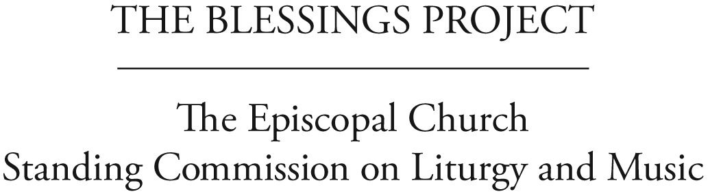
Helping Dioceses Understand
the response to 2009 GC Resolution C056
Liturgies for Blessing
Same-Gender Relationships
Theological Reflection
Notes:
Theological Reflection on Same-Gender Relationships
Purpose: To engage members of a diocese in brief theological reflection upon the work of the Commission and encourage them to further study after the full report is released.
Preparation: Ask one member of the General Convention Deputation to be ready to explain about C-056, the charge to the SCLM and then introduce the process and material. (NOTE: These three explanations are available on the accompanying PowerPoint). S/he should also be the time keeper. This “table discussion format” is designed for between 10 and 15 minutes, as we assume convention timing is tight. Have copies of the one-page SCLM document Faith, Hope, and Love: Theological Reflection on Same-Gender Relationships on the tables (or if people are seated in rows, given to them ahead of time) and ask them to follow the discussion format either presented on the PowerPoint presentation or copied on back of the handout. If people are not at tables, invite them to form small clusters of 3 or 4 people.
1. Briefly explain why the Deputation is doing this (open process; want Episcopalians engaging the material; want feedback, etc.). Ask people to be open and respectful of diverse opinions. Explain this is a “taste” of the type of process in which the SCLM hopes the church will engage.

Slide 2
How We Got Here
The Episcopal Church’s General Convention working for 35 years:
1976: First discussion and resolution:
homosexual persons are children of God
2000: Clarity about same-gender couples:
such relationships will be characterized by fidelity, monogamy, mutual affection and respect, careful, honest communication, and holy love
2003: Liturgies celebrating/blessing relationship:
within the bounds of our common life
Discussions and resolutions also in
1985,1991, 1994, 1997
Notes:
Quickly show the process that got us here via General Convention resolutions and the SCLM’s charge and work on C-056.

Slide 3
Resolution 2009-C056
General Convention:
Acknowledged that changing circumstances in civil realities needed renewed pastoral response
Asked for an open process inviting wide participation
Asked the Standing Commission on Liturgy and Music to:
  Work with the House of Bishops, collect and develop theological and liturgical resources for blessing same-gender relationships and report back in 2012
  Honor the theological diversity of this Church in regard to matters of human sexuality
  Encourage church members to engage in this effort
Notes:
Quickly show the process that got us here via General Convention resolutions and the SCLM’s charge and work on C-056.

Slide 4
In response, the SCLM . . .
Formed 4 Task Groups: Liturgy, Theology, Pastoral & Teaching, Civil/Canon Law
Met and consults with the House of Bishops
Held Province I Hearing (testimony from 33 people, lay and ordained)
Conducted church-wide survey regarding pastoral counseling and teaching materials (received responses from 1,131 people from 111 dioceses and all 9 Provinces)
Held Church-wide Consultation (included 194 deputies, lay and clergy, from 96 dioceses)
Asked outside consultants to review draft material (comments from 133 people, lay and ordained, from all 9 Provinces)
Invited reflection at the International Anglican Liturgical Consultation (55 people from 19 Anglican Provinces)
Notes:
Quickly show the process that got us here via General Convention resolutions and the SCLM’s charge and work on C-056.

Slide 5
Theological Reflection
Review the document Theological Reflection on Covenantal Relationship: Spiritual Practice for Same-Gender Couples. Briefly discuss:
Which of these themes (vocation, households, fruitfulness, mutual blessing) speak most directly to your experience of relationship, either your own relationship or one in your community?
Could these same themes apply to same-gender couples? What other ways would you describe the spiritual significance of such committed relationships in the life of your community?
Notes:
Invite people to briefly review the theological themes that the Commission has articulated for same-gender relationships in the SCLM document, Faith, Hope, and Love: Theological Reflection on Same-Gender Relationships. Then, ask participants to share:
Which of these themes (covenant, household, vocation, fruitfulness, mutual blessing) speak most directly to your own experience of relationship, either your own or a relationship in your community?
Could these same themes apply to same-gender couples and/or what other ways would you describe the spiritual significance of such committed relationships in the life of your community?

Slide 6
Thank you!
Please share with your deputation:
the two or three most important things
you learned from the conversation
For further study:
http://liturgyandmusic.wordpress.com/
category/resources-for-same-gender-blessings/
Notes:
Wrap up the exercise and invite members to jot down and give to the Deputation a list of the two or three most important things they learned from the conversation. Let them know that you will share that information with the SCLM as part of the ongoing open process leading to General Convention. Direct them to the SCLM website for further study.

