Slide 1


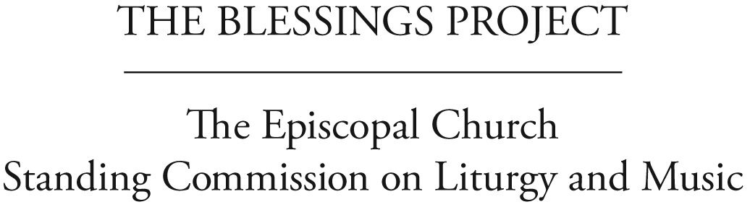
Helping Dioceses Understand
the response to 2009 GC Resolution C056
Liturgies for Blessing
Same-Gender Relationships
Understanding Resolution C056
Notes:
Purpose: To engage members of a diocese in understanding the charge given in the resolution and the way the Standing Commission on Liturgy and Music responded.
Preparation: Ask one member of the General Convention Deputation to be ready to introduce the process and material. S/he should also be the time keeper. This “table discussion format” is designed for between 10 and 15 minutes, as we assume convention timing is tight. Have copies of the C-056 Resolution on the tables (or if people are seated in rows, given to them ahead of time) and ask them to follow the discussion format either presented on the PowerPoint presentation or copied on back of the handout. If people are not at tables, invite them to form small clusters of 3 or 4 people.
1. Briefly explain why the Deputation is doing this (open process; want Episcopalians engaging the material; want feedback, etc.) Ask people to be open and respectful of diverse opinions. Explain this is a “taste” of the type of process in which the SCLM hopes the church will engage.

Slide 2
How We Got Here
The Episcopal Church’s General Convention working for 35 years:
1976: First discussion and resolution:
homosexual persons are children of God
2000: Clarity about same-gender couples:
such relationships will be characterized by fidelity, monogamy, mutual affection and respect, careful, honest communication, and holy love
2003: Liturgies celebrating/blessing relationship:
within the bounds of our common life
Discussions and resolutions also in
1985,1991, 1994, 1997
Notes:
Show the slide which gives a brief history of how the Episcopal Church got to C-056. If you are not using PowerPoint read them the items.

Slide 3
Resolution 2009-C056
Please quickly read 2009 General Convention Resolution C056. Briefly discuss:
What “action items” does this resolution call for?
What would you have expected the Standing Commission on Liturgy and Music to do in response?
Notes:
Then, ask everyone to read Resolution 2009-C056 and ask them briefly to discuss:
1. What are the “action items” this resolution calls for?
2. What would you have expected the Standing Commission on Liturgy and Music to do?
Consider allowing time for discussion in small groups.

Slide 4
How DID the Commission Respond?
Open Process
Spring 2010: Created 4 Task Groups to work on the Liturgical, Theological, Pastoral & Teaching, and Civil/Canon Law aspects of the work.
July 2010: Secured funding for the work. The Task Groups met this month and 4 more times over the next 14 months.
September 2010: Consultation with the House of Bishops.
October 2010: Province I Hearing. At the hearing, 33 people, lay and ordained, testified about their experiences.
Notes:
After about 5 minutes ask the members of the convention to draw their attention to these next PowerPoint slides and show them the process in which the SCLM engaged. If you are not using PowerPoint read them the items.

Slide 5
Open Process (continued)
October 2010–January 2011: Church-wide Web-based Survey Regarding Pastoral Counseling and Teaching Materials. Received 1,131 responses to the survey, representing 111 dioceses and all 9 Provinces.
March 2011: Church-wide Consultation. Invited each diocese to send one lay deputy and one clergy deputy. 194 deputies from 96 dioceses attended.
July 2011: Review of Draft Resources. Received comments from 133 people, lay and ordained, representing all 9 provinces.
September 2011: Opportunity for House of Bishops to review final drafts.
Ongoing: Informal networks of bishops and task group members in and across dioceses.

Slide 6
Inviting theological reflection from throughout the Anglican Communion
The Anglican Church of Canada shared insights and liturgies.
Bishops of The Episcopal Church invited to share Liturgical and Theological principles with Anglican bishops.
Reflection at the August 2011 International Anglican Liturgical Consultation (IALC) included 55 people from 19 Provinces of the Anglican Communion.

Slide 7
Thank you!
Please share with your deputation:
the two or three most important things
you learned from the conversation
For further study:
http://liturgyandmusic.wordpress.com/
category/resources-for-same-gender-blessings/
Notes:
Wrap up the exercise and invite members to jot down and give to the Deputation a list of the two or three most important things they learned from the conversation. Let them know that you will share that information with the Commission as part of the ongoing open process leading to General Convention. Direct them to the Commission website for further study.

