Slide 1

Contents of Marriage Task Force
“Conversation Carry-on”
Contents
Design Principles
Invitation Strategy & Invitation
Poster/Advertisement
Facilitator Role Guidelines
Event Designs
  1 – 90 Minute Event
  3 – 35 Minute Events
Facilitator Guide
Conversation/Question Slides
Form for documenting the meeting
Please submit the documentation page from your conversation event via email to: taskforceonmarriage@gmail.com or mail to:
The Rev. Brian Taylor, Marriage Task Force Chair
1401 Los Arboles N. W.
Albuquerque, NM 87107

Slide 2
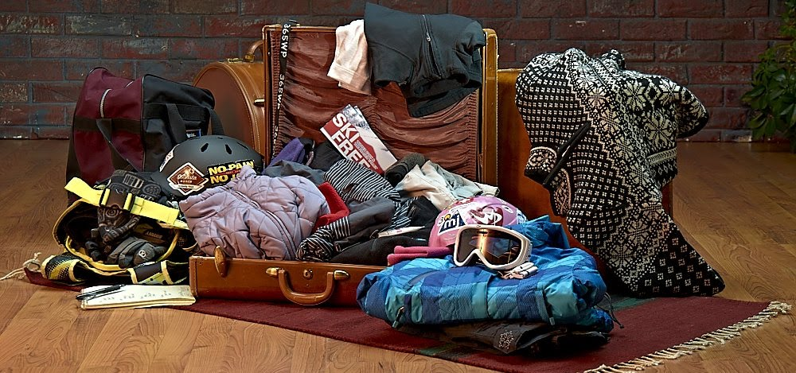
This “carry-on” is designed for . . .
Conversations that feature:
  participation
  engagement
  and collaboration
A process that is:
  open
  welcoming
  upbeat
  stimulating
  and flexible enough for a variety of settings, group sizes and demographics

Slide 3
Invitation Strategy
Try to involve people who offer divergent points of view about marriage
Try to involve people who are single, newly married, married for a long time, in other partnered relationships, divorced, widowed, etc.
Try to involve people who are currently active in the Church, those who are less active and those who have little or no affiliation with the Church.
Offer to do sessions for groups that are already meeting for another purpose.
Suggestion for Invitation
Dear (Friend, Colleague, Church Member, etc.)
We invite your participation in a conversation about the history of marriage, the biblical and theological dimensions of marriage and the trends and changing norms of marriage. In 2012, The General Convention of The Episcopal Church created a Task Force for the Study of Marriage. Members of this Task Force have developed a resource for engaging as many people as possible in a conversation about the subject of marriage. We are holding a 90 minute session (or three 35 minute sessions) on (day and date) at (time) at (location). I would be pleased if you could join us and the conversation about this important subject. Please let me know if you are interested and available to participate.

Slide 4
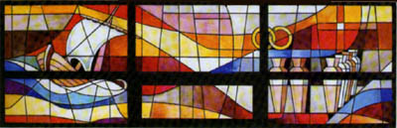
Join us for a conversation about the history, biblical and theological dimensions and changing norms of marriage
WHO Everyone and anyone who is interested in marriage and the future shape of marriage
WHY In 2012, The General Convention of The Episcopal Church created a Task Force to study marriage. Members of the Task Force are encouraging conversations about marriage throughout our Church. We invite you to participate in a conversation about the history, biblical and theological dimensions of marriage, as well as the changing norms and current trends.
WHEN ………………………………………………………….
WHERE ………………………………………………………..

Slide 5
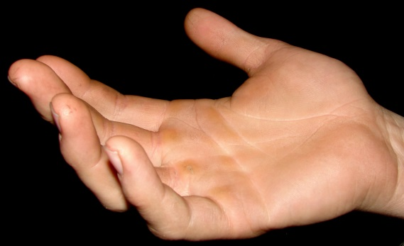
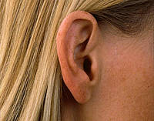
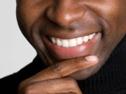
The Facilitator’s Role
•Create a comfortable, welcoming environment.
•Encourage participation by all present.
•Explain the purpose of the event and time constraints.
•Outline the structure for the event and distribute materials.
•Avoid any temptation to lecture, explain, argue, rebut, revise or otherwise get in the way of allowing people to express themselves. We want to hear from them!
•Consider appointing someone to record key responses from participants.

Slide 6
DESIGNS
90 Minutes – One Session
Welcome, Prayer and Overview
One minute story of a relationship in which you have seen the image of God
History of Marriage
Changing Norms and Trends
Biblical and Theological Dimensions
Thank You and Closing Prayer
OR
3 - 35 Minute Sessions
Welcome, Prayer and Overview (each session)
One minute story of a relationship in which you have seen the image of God (each session)
Session One – History of Marriage
Session Two – Changing Norms and Trends
Session Three – Biblical and Theological Dimensions
Thank You and Closing Prayer (each session)

Slide 7
“Carry-on Conversation” Facilitator Guide
Module | 90 Minute Design | 3 – 35 Minute Sessions Design | Materials
WELCOME & OVERVIEW 5 min. | Gather and introductions Prayer for Guidance - #57 or 58 BCP page 832 Overview and Context for this conversation Hand out packets with three one page summary documents for use during the session | Gather and introductions Prayer for Guidance - #57 or 58 BCP page 832 Overview and Context for this conversation | Slides 1,2
STORIES OF RELATIONSHIPS 5-10 minutes | Guided by principles laid out in General Convention Resolution D039-2000, which names values that the church upholds for its members in relationships: "fidelity, monogamy, mutual affection and respect, careful, honest communication, and the holy love which enables those in such relationships to see in each other the image of God:“ Tell a one minute story about your relationship or one you know well in which you have seen the image of God. (in triads) Invite people to record and send one minute video to taskforceonmarriage@gmail.com AND/OR post written response to www.facebook.com/A050taskforce | Each time you gather begin with this exercise Guided by principles laid out in General Convention Resolution D039-2000, which names values that the church upholds for its members in relationships: "fidelity, monogamy, mutual affection and respect, careful, honest communication, and the holy love which enables those in such relationships to see in each other the image of God:” Tell a one minute story about your relationship or one you know well in which you have seen the image of God. (in triads) Invite people to record and send one minute video to taskforceonmarriage@gmail.com AND/OR post written response to www.facebook.com/A050taskforce | Slide 9 Stories of Relationships

Slide 8
Module | 90 Minute Design | 3 – 35 Minute Sessions Design | Materials
HISTORY OF MARRIAGE 20-25 minutes | Use one page summary of the key aspects regarding the history of marriage. Conversation and sharing of responses to these questions: (large group) QUESTIONS: What did you find surprising/affirming/unsettling about this historical synopsis? How does this history help inform our contemporary understanding of marriage? (record key responses) | Session One Use one page summary of the key aspects regarding the history of marriage. Conversation and sharing of responses to these questions: (large group) QUESTIONS: What did you find surprising/affirming/unsettling about this historical synopsis? How does this history help inform our contemporary understanding of marriage? (record key responses) | Slide 11 History of Marriage
CHANGING NORMS AND TRENDS 20-25 minutes | Use one page summary of key trends & changes in norms vis-à-vis marriage Conversation and sharing of responses (in small groups or 5-6) QUESTION: How might these trends and others of which you are aware influence how the church understands marriage? | Session Two Use one page summary of key trends & changes in norms vis-à-vis marriage Conversation and sharing of responses (in small groups or 5-6) QUESTION: How might these trends and others of which you are aware influence how the church understands marriage? | Slide 12 Changing Norms and Trends
BIBLICAL AND THEOLOGICAL DIMENSIONS 20-25 minutes | Use one page summary of key biblical and theological themes/issues regarding how the church understands marriage. QUESTION: Which of these themes is most central to your understanding of Christian marriage? (small groups of 5-6) | Session Three Use one page summary of key biblical and theological themes/issues regarding how the church understands marriage. QUESTION: Which of these themes is most central to your understanding of Christian marriage? (small groups of 5-6) | Slide 13 Biblical and Theological Dimensions

Slide 9
MODULE | 90 Minute Design | 3 – 35 Minute Sessions Design | Materials
THANKS & CLOSING PRAYER 5 minutes | Thank You Closing prayer: Lord’s Prayer and/or one chosen by facilitator | Do this for each session Thank You Closing prayer: Lord’s Prayer and/or one chosen by facilitator | Slide 14

Slide 10
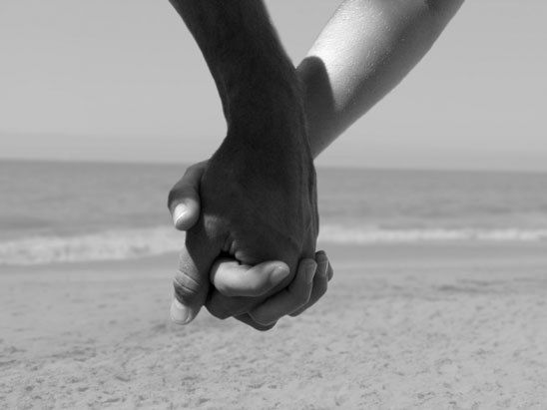
Tell a one minute
story about your
relationship, or
one you know well,
in which you have
seen the image of
God.

Slide 11
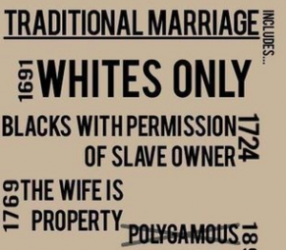
HISTORY OF MARRIAGE
What did you find surprising/affirming/unsettling about this historical synopsis?
How does this history help inform our contemporary understanding of marriage?

Slide 12
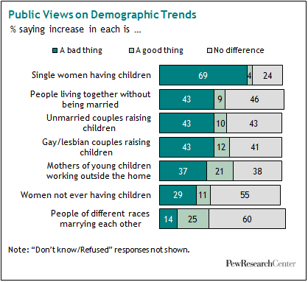
CHANGING NORMS AND TRENDS
How might these trends and others of which you are aware influence how the church understands marriage?

Slide 13

BIBLICAL AND THEOLOGICAL THEMES
Which of these themes is most central to your understanding of marriage?

Slide 14
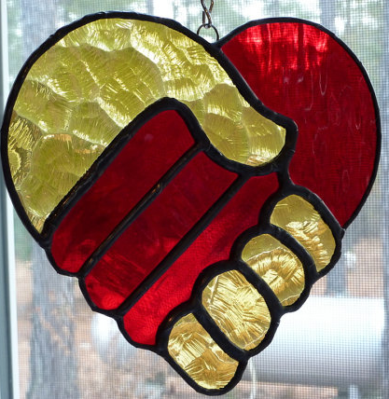
THANK YOU!

Slide 15
Meeting Documentation
Please submit the documentation page from your conversation event via email to: taskforceonmarriage@gmail.com or mail to:
The Rev. Brian Taylor, Marriage Task Force Chair
1401 Los Arboles N. W.
Albuquerque, NM 87107
LOCATION (Church, Town, State or Province, Country)
FACILITATOR NAME
GROUP PROFILE (Parishioners, Staff, Youth Group, etc.)
# IN GROUP
DATE
1 OR 3 SESSION FORMAT?
For Facilitators: Please recap the fruits of your conversation and share anything else you would like with the Task Force (use extra pages as needed).

